Slide 1


Automation
COM Programming
Notes:
Page <number>
WNCOMPG-2 v1.5
Chapter 8, Automation

Slide 2


Chapter Overview
Objectives
  Explain the technology behind Automation
  Build a simple Automation object using ATL
Chapter content
  IDispatch
  Dual interfaces
  Error handling
Practical content
  Use a scripting client
  Experiment with dual interfaces
Summary
Notes:
Page <number>
WNCOMPG-2 v1.5
Chapter 8, Automation

Slide 3
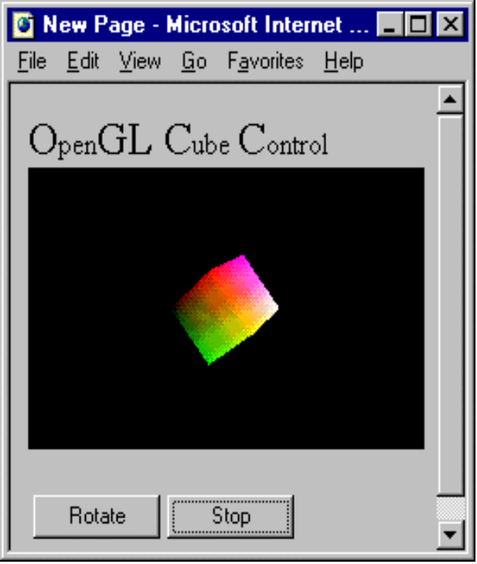
What is Automation?
Allows one application to drive another
  Server can expose one or more objects
  Controller can create and manipulate these objects
  Controller can be written in a scripting-language such as VBScript
<SCRIPT LANGUAGE="VBSCRIPT">
Sub RotateBtn_OnClick
VTOpenGL1.xDegrees=5
VTOpenGL1.yDegrees=5
VTOpenGL1.zDegrees=5
VTOpenGL1.Rotate 1
End Sub
</SCRIPT>
Notes:
Page <number>
WNCOMPG-2 v1.5
Chapter 8, Automation

Slide 4
How Does it Work?
A COM object can offer services through a single standard interface called IDispatch
  A "gateway" to a collection of methods called a dispinterface
  Allows a client to execute a function by name
  Allows a scripting-language client to use object
IDispatch Interface
Dispinterface
Virtual function table
Function
Name
DISPID
pIDispatch
pvtbl
QueryInterface
GetIDsOfNames
function
Balance
1
AddRef
Release
Deposit
2
GetTypeInfoCount
Withdraw
3
GetTypeInfo
DISPID
Function
pointer
GetIDsOfNames
Invoke
Invoke
function
1
Balance
2
Deposit
3
Withdraw
Notes:
Page <number>
WNCOMPG-2 v1.5
Chapter 8, Automation

Slide 5
Dispatch IDs
Each method, property and method argument is identified by a locale-independent DISPID
  A LONG number, not a GUID
  Unique only to a specific implementation of IDispatch
  Specified in IDL using id() attribute
  Method-argument DISPIDs are assigned automatically
import "oaidl.idl";
import "ocidl.idl";
[
uuid(xxxxxxxx-xxxx-xxxx-xxxx-xxxxxxxxxxxx),
]
dispinterface IAccount
{
properties:
[id(1), readonly] float Balance;
methods:
[id(2)] HRESULT Deposit([in] float amount);
[id(3)] HRESULT Withdraw([in] float amount);
};
Defines Automation types, etc.
Defines a pure Automation interface - implicitly inherits from IDispatch
Notes:
Page <number>
WNCOMPG-2 v1.5
Chapter 8, Automation

Slide 6
IDispatch
interface IDispatch : IUnknown {
HRESULT GetTypeInfoCount([out] UINT *pctinfo);
HRESULT GetTypeInfo([in] UINT iTinfo,
[in] LCID lcid,
[out] ITypeInfo **ppTinfo);
HRESULT GetIDsOfNames([in] REFIID riid,
[in, size_is(cNames)] LPOLESTR *rgszNames,
[in] UINT cNames,
[in] LCID lcid,
[out, size_is(cNames)] DISPID *rgDispid);
HRESULT Invoke([in] DISPID dispIdMember,
[in] REFIID riid,
[in] LCID lcid,
[in] WORD wFlags,
[in, out] DISPPARAMS *pDispParams,
[out] VARIANT *pVarResult,
[out] EXCEPINFO *pExcepInfo,
[out] UINT *puArgErr);
};
Is there any type information?
Give me the type information
Give me the DISPIDs of these methods or properties
Execute the function or property identified by this DISPID
Notes:
Page <number>
WNCOMPG-2 v1.5
Chapter 8, Automation

Slide 7
GetIDsOfNames() Arguments
Reserved. Must be IID_NULL
Array of function names
Number of names
GetIDsOfNames([in] REFIID riid,
[in, size_is(cNames)] LPOLESTR *rgszNames,
[in] UINT cNames,
[in] LCID lcid,
[out, size_is(cNames)] DISPID *rgDispid);
Identifies a locale for national language support
Array of dispatch IDs
Notes:
Page <number>
WNCOMPG-2 v1.5
Chapter 8, Automation

Slide 8
Invoke() Arguments
Unique number that identifies
the method to invoke
Flag that specifies the action to which DISPID refers.
Must be one of the following values:
DISPATCH_METHOD Object method
DISPATCH_PROPERTYGET Get property value
DISPATCH_PROPERTYPUT Set property value
DISPATCH_PROPERTYPUTREF Set property by reference
Reserved. Must be IID_NULL
Invoke([in] DISPID dispIdMember,
[in] REFIID riid,
[in] LCID lcid,
[in] WORD wFlags,
[in, out] DISPPARAMS *pDispParams,
[out] VARIANT *pVarResult,
[out] EXCEPINFO *pExcepInfo,
[out] UINT *puArgErr);
Locale ID
Structure that contains parameters to pass to the method
Result from calling the method
Returned exception-information
Index of first argument in error
Notes:
Page <number>
WNCOMPG-2 v1.5
Chapter 8, Automation

Slide 9
A Simple C++ Client
// error checking deleted for clarity
// create the component
IDispatch *pDisp = NULL;
CoCreateInstance( CLSID_Account, NULL, CLSCTX_INPROC_SERVER,
IID_IDispatch, (void**)&pDisp );
// get DISPID for dispatch function Beep()
DISPID dispId;
LPOLESTR pNames = L"Beep";
hr = pDisp->GetIDsOfNames( IID_NULL, &pNames, 1,
LOCALE_USER_DEFAULT, &dispId );
// lucky no arguments!
DISPPARAMS dispParams = {NULL, NULL, 0, 0};
// invoke the function
pDisp->Invoke( dispId, IID_NULL, LOCALE_USER_DEFAULT,
DISPATCH_METHOD, &dispParams, NULL, NULL,
NULL );
Notes:
Page <number>
WNCOMPG-2 v1.5
Chapter 8, Automation

Slide 10
A More Complex C++ Client
// allocate and initialise a VARIANT argument
VARIANTARG varg;
VariantInit( &varg );
varg.vt = VT_BSTR;
varg.bstrVal = SysAllocString( L"Test string from client" );
// fill in a DISPPARAMS structure and invoke the function
DISPPARAMS dispParams;
dispParams.cArgs = 1; // one argument
dispParams.rgvarg = &varg; // pointer to argument
dispParams.cNamedArgs = 0; // no named arguments
dispParams.rgdispidNamedArgs = NULL;
pIDispatch->Invoke( dispID, IID_NULL, LOCALE_USER_DEFAULT,
DISPATCH_METHOD, &dispParams, NULL,
NULL, NULL );
// clean up
VariantClear( &varg );
Notes:
Page <number>
WNCOMPG-2 v1.5
Chapter 8, Automation

Slide 11
Dual Interfaces
A dual interface is one that inherits from IDispatch
  Scripting-language clients can call methods through Invoke()
  C++ and Visual Basic clients can call same methods through vtable (for best performance)
IAccount Interface (inherits from IDispatch)
Dispinterface
Virtual function table
Function
Name
pIDispatch
pIAccount
DISPID
pvtbl
QueryInterface
GetIDsOfNames
function
Balance
1
AddRef
Release
Deposit
2
GetTypeInfoCount
Withdraw
3
GetTypeInfo
GetIDsOfNames
Invoke
Invoke
function
1
Balance
2
Deposit
3
Withdraw
Notes:
Page <number>
WNCOMPG-2 v1.5
Chapter 8, Automation

Slide 12
Automation-Compatible Types
Type
IDL Type Name
Representation
integer
short
long
16-bit signed integer
32-bit signed integer
floating point
float
double
32-bit IEEE floating point number
64-bit IEEE floating point number
boolean
VARIANT_BOOL
Unsigned char (TRUE or FALSE)
character
unsigned char
8-bit unsigned data item
string
BSTR
Length-prefixed string
array
SAFEARRAY(type)
Bounded array of type
status
HRESULT
Built-in error type
interface pointers
IUnknown *
IDispatch *
Pointer to interface other than IDispatch
Pointer to IDispatch interface
Notes:
Page <number>
WNCOMPG-2 v1.5
Chapter 8, Automation

Slide 13
Example of a Dual Interface
Import Automation types
// SimpleAccount.idl ----------------------
import "oaidl.idl";
import "ocidl.idl";
[
object,
uuid(81B8FDDC-FB37-11D2-9C81-000000000000),
dual,
pointer_default(unique)
]
interface IAccount : IDispatch
{
[id(1)] HRESULT Deposit([in] float amount);
[id(2)] HRESULT Withdraw([in] float amount);
[propget, id(3)]
HRESULT Balance([out, retval] float *pVal);
};
dual keyword
Inherit from
IDispatch
Return
HRESULT
DispID
Automation-compatible
type
Read-only property
Return value
Notes:
Page <number>
WNCOMPG-2 v1.5
Chapter 8, Automation

Slide 14
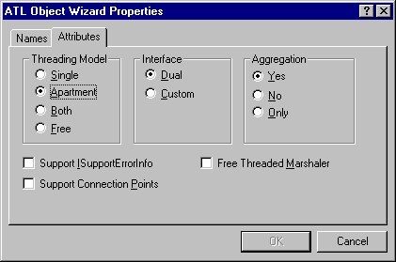
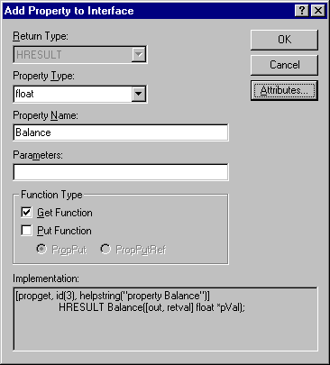
Building an Automation Object
Easy using ATL
  By default, ATL Object Wizard defines an object with a dual interface
  DispIDs are assigned automatically when adding methods and properties through ClassView
Notes:
Page <number>
WNCOMPG-2 v1.5
Chapter 8, Automation

Slide 15
Code Generated by Object Wizard
Account.h
// Account.h : Declaration of the CAccount
...
// CAccount
class ATL_NO_VTABLE CAccount :
public CComObjectRootEx<CComSingleThreadModel>,
public CComCoClass<CAccount, &CLSID_Account>,
public IDispatchImpl<IAccount, &IID_IAccount,
&LIBID_SIMPLEACCOUNTLib> {
...
BEGIN_COM_MAP(CAccount)
COM_INTERFACE_ENTRY(IAccount)
COM_INTERFACE_ENTRY(IDispatch)
END_COM_MAP()
...
Notes:
Page <number>
WNCOMPG-2 v1.5
Chapter 8, Automation

Slide 16
IDispatchImpl<>
atlcom.h
template <class T,
const IID* piid,
const GUID* plibid = &CComModule::m_libid,
WORD wMajor = 1,
WORD wMinor = 0,
class tihclass = CComTypeInfoHolder>
class ATL_NO_VTABLE IDispatchImpl : public T {
public:
typedef tihclass _tihclass;
// IDispatch
STDMETHOD(GetTypeInfoCount)(UINT* pctinfo) {
*pctinfo = 1;
return S_OK;
}
STDMETHOD(GetTypeInfo)(UINT itinfo, LCID lcid,
ITypeInfo** pptinfo) {
return _tih.GetTypeInfo(itinfo, lcid, pptinfo);
}
...
Notes:
Page <number>
WNCOMPG-2 v1.5
Chapter 8, Automation

Slide 17


Summary
An Automation object must implement IDispatch or provide a dual interface
IDispatch is a standard interface
  GetTypeInfoCount()
  GetTypeInfo()
  GetIDsOfNames()
  Invoke()
A dual interface is one that inherits from IDispatch
  Scripting-language clients can call methods through Invoke()
  C++ and Visual Basic clients can call same methods through vtable
Only data that can be held in a VARIANT can be passed via a dispatch interface
By default, ATL Object Wizard defines an object with a dual interface
Notes:
Page <number>
WNCOMPG-2 v1.5
Chapter 8, Automation

